Slide 1

Who are You Online?

Slide 2

Representation Online
Does the way you represent yourself online differ from the way you represent yourself offline?
What is similar and what is different about your online and offline selves?
What does it mean to have an online persona?
Notes:
DISCUSS the idea that the Internet gives people the chance to express different parts of themselves and even try
on different personas.
In the lesson, they will explore how they represent themselves online, and all the possibilities,
risks, and benefits involved in experimenting with their online selves.
Persona: an image and personality that you show to others

Slide 3

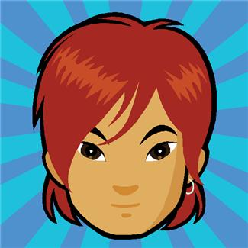
Online Personas
New York Times Magazine Slideshow
  Illustrates how people represent themselves online.
  Real people & the avatars they use in virtual worlds.
Expectations:
  For each slide, write down at least one similarity/difference between the person & their avatar.
  Do not pass judgment or make fun of the avatar
  Your notes should go beyond physical characteristics
  Try to determine WHY these individuals chose their avatar.
  Be ready to discuss as a group
Notes:
students that they are about to see a slideshow that illustrates how people represent themselves online.
The slideshow features photos of real people alongside images of the avatars they use in virtual worlds.
(Students should understand that they cannot be
certain of these people’s intentions without talking to them – they can draw conclusions based only on the
information available in the photos.)

Slide 4
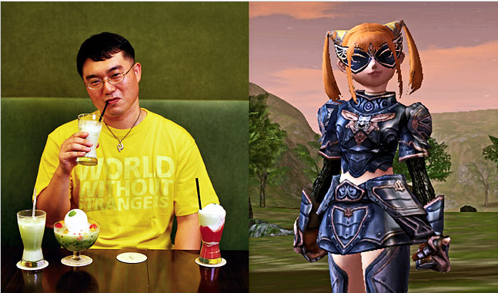
Avatar Slideshow
#1:
Notes:
Slide 1: Choi Seang Rak might represent himself as a girl because he’ll do better in the game he’s playing.
Or maybe he wants to explore how others might treat a girl online.
NAME Choi Seang Rak BORN 1971 OCCUPATION Academic LOCATION Seoul, South Korea AVATAR NAME Uroo Ahs AVATAR CREATED 2004 GAME PLAYED Lineage II HOURS PER WEEK IN-GAME 8 CHARACTER TYPE Dwarf Warsmith SPECIAL ABILITIES Craft siege weapons, whirlwind in battle

Slide 5
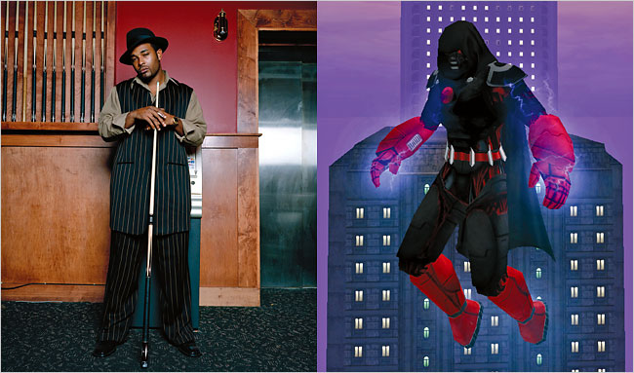
Avatar Slideshow
#2:
Notes:
Slide 2: Tommy D. Graves might represent himself as a superhero who looks nothing like him because he
wants to be anonymous and live out a total fantasy when he plays the game.
NAME Tommy D. Graves BORN 1978 OCCUPATION Bouncer, recording engineer, recording artist LOCATION Bedford, Tex. AVATAR NAME War Catalyst AVATAR CREATED 2004 GAME PLAYED City of Heroes HOURS PER WEEK IN-GAME 15 CHARACTER TYPE Electric blaster SPECIAL ABILITIES Flying, enhanced stamina

Slide 6
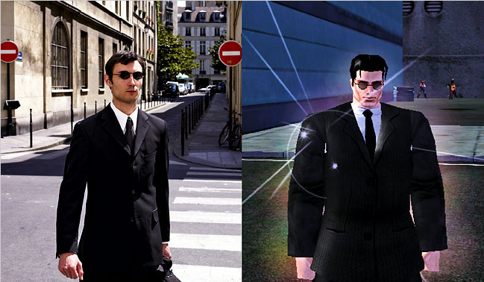
Avatar Slideshow
#3:
Notes:
Slide 3: Jean-François de la Fage might want to feel like a stronger, tougher version of himself.
NAME Jean-François de la Fage BORN 1979 OCCUPATION Journalist LOCATION Paris AVATAR NAME Dark Freeman AVATAR CREATED 2005 GAME PLAYED City of Heroes HOURS PER WEEK IN-GAME 21 CHARACTER TYPE Natural hero SPECIAL ABILITIES Invincibility

Slide 7
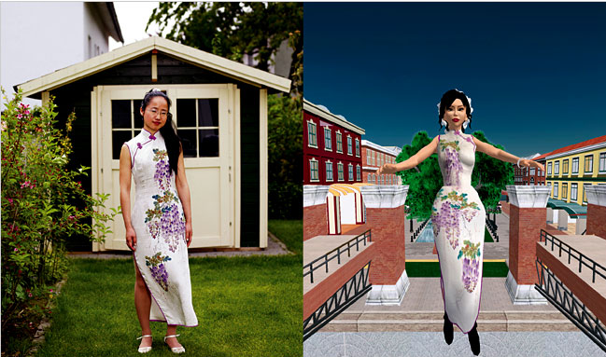
Avatar Slideshow
#4:
Notes:
Slide 4: Ailin Graef might want an avatar that looks like her, wearing her favorite dress and with her best
qualities exaggerated.
NAME Ailin Graef BORN 1978 OCCUPATION Metaverse entrepreneur LOCATION Frankfurt AVATAR NAME Anshe Chung AVATAR CREATED 2004 GAME PLAYED Second Life HOURS PER WEEK IN-GAME 30

Slide 8
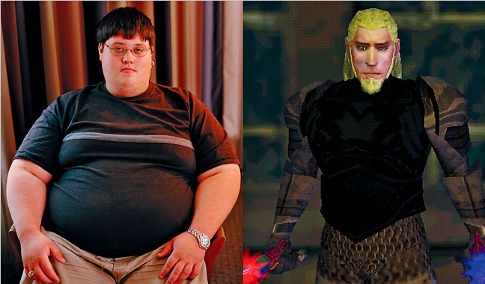
Avatar Slideshow
#5:
Notes:
Slide 5: Lucas Shaw seems to have created a barbarian character to match the virtual world of the game he
is playing, rather than an avatar that resembles himself. He might want to escape to a fantasy world.
NAME Lucas Shaw BORN 1985 OCCUPATION Student LOCATION Texas AVATAR NAME Gaenank AVATAR CREATED 2003 GAME PLAYED EverQuest HOURS PER WEEK IN-GAME 55 CHARACTER TYPE Barbarian berserker SPECIAL ABILITIES Dual wield

Slide 9
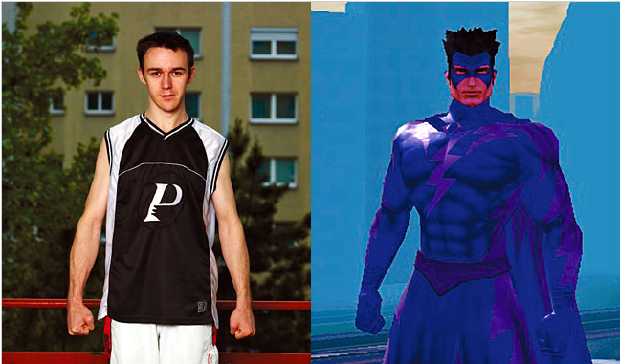
Avatar Slideshow
#6:
Notes:
Slide 6: Andreas Fisher is posing like his avatar, so he seems to be exploring the side of himself that wants
to act like a superhero.
NAME Andreas Fischer BORN 1980 OCCUPATION Designer LOCATION Vienna AVATAR NAME Zero Cold AVATAR CREATED 2005 GAME PLAYED City of Heroes HOURS PER WEEK IN-GAME 17 CHARACTER TYPE Human SPECIAL ABILITIES Controls ice and storms

Slide 10
Discussion
Remember…
  Share the observations from your own notes
  When people create avatars they make choices based on the kind of online world their avatar will be in.
  How does an avatar designed for a social networking site differ from virtual world like Second Life or for a competitive gaming site?

Slide 11
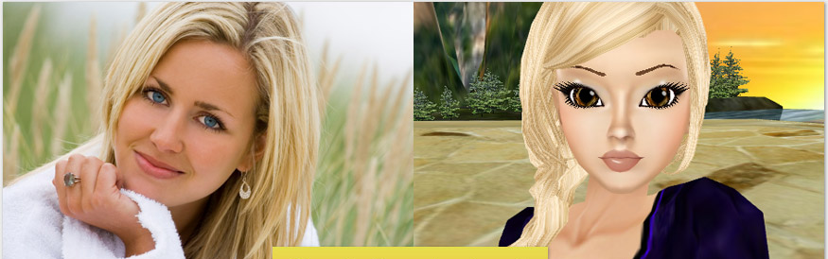
Being “Real” vs. “Fake”
What do you think it means to be “real” or “fake?”
Do you think it’s easier for people to be “fake” online than in real life? Why or why not?
Notes:
The following video is about teens who are answering these types of questions

Slide 12

Being “Real” vs. “Fake”
“Ramon’s Story– Being Real Online”
Notes:
The following video is about teens who are answering these types of questions

Slide 13
Being “Real” vs. “Fake”
Movie Discussion…
Ramon talks about how some people exaggerate or seem very different online than in person.
How do you explain these differences between their
online and in-person personas?
Notes:
Guide students to draw on points that Ramon has made. He
thinks some people want to seem tougher or cooler than they
are offline so they will be more accepted.

Slide 14

Being “Real” vs. “Fake”
Movie Discussion…
Are there risks for creating an online presence that is very different than the offline one?
Are there benefits?
Notes:
Guide students to identify risks, such as setting up false
expectations for others, spurring violence, and depending
on online communication to the detriment of in-person
communication. Benefits are that you can enter interest-
driven communities that you couldn’t before, you can
take time to compose your thoughts before responding to
others, and you can experiment with the opinions you put
forth and how you present yourself.

Slide 15

Being “Real” vs. “Fake”
Movie Discussion…
What are other reasons why people might feel they can act in ways online that they wouldn’t act offline?
Notes:
Sample responses:
You have time to plan what you want to say, and you can
shape how you want to come across to others.
You can’t see other people’s faces, so you don’t see their
reactions.
Because you can’t see other people, you might behave
differently based on your assumptions about who you
think they are and what they’re like online

Slide 16


Anonymous vs. Inhibited
What does it mean to be anonymous?
What does it mean to be inhibited?
Notes:
Anonymous: without a name or other information that identifies who you are
Inhibited: careful or restrained about your actions or impulses
DISCUSS
the idea that people may feel less inhibited when they are online. This is especially true if they are
anonymous or are interacting with people who don’t know them offline. (Even when they know the people, it’s
easy for people to feel anonymous when they are online, because they are alone with their computer or phone.)
People might feel free to invent new personas online, or they might change particular parts of themselves

Slide 17

Anonymous vs. Inhibited
Are there any benefits to being anonymous or being less inhibited online?
Notes:
Some reasons include:
You might feel freer to say things you’re really thinking.
You might be able to try things out that you can’t in the
offline world.
You can highlight or emphasize the parts of yourself that
you feel good about.

Slide 18

Anonymous vs. Inhibited
Are there risks involved with being anonymous or less inhibited online?
Notes:
Some reasons include:
You are not accountable for your actions, so you might do
or say things you wouldn’t offline.
You might behave in ways that are unsafe or harmful to
yourself.
You might behave in ways that are disrespectful or harmful
to others.

Slide 19

How do I stay “real?”
It may be possible to “stay real,” even when they are representing themselves in different ways online.
Stay true to who you are & to how you would treat yourself & others in the offline world.

Slide 20
Staying “real” task…
Work with a partner to come up with a set of rules for “Staying Real Online.”
Examples include:
  Present yourself in a way that’s positive and not harmful to you.
  Treat people the way you would treat them in person.
  Don’t say or do things that harm other people, or betray their trust.
  Never get into a relationship that is not safe.
  Avoid getting involved in a community that is not appropriate.

Slide 21

Staying “real” task…
Share your list with the class…
Notes:
At this point, you may also choose to compile lists so that you can get a class set of rules for staying “real” online and post in your room.

Slide 22
What do you Know?!
See how much you remember by testing your knowledge on the following questions…

Slide 23

What do you Know?!
Offline, Tyrone is shy and gets made fun of at school. Online, Tyrone is outgoing and feels popular.
Why might Tyrone feel he can be outgoing and popular online when he is shy and unpopular at school?
  a) Tyrone has a funny screen name
  b) Tyrone can’t see other people online, so he feels he can behave differently than he would offline
  c) Tyrone has more time to plan what he says to people online
  d) Both b and c
Notes:
d) Both b and c
Answer feedback
The correct answer is
d
. Oftentimes people feel less shy online because they are not interacting with
others face to face.

Slide 24
What do you Know?!
What are some risks and some benefits to presenting yourself differently online than you present yourself offline? (Which ones are risks & which are benefits?)
  a) You might behave in ways that are unsafe or harmful to yourself
  b) You might be able to try things out that you normally wouldn’t or couldn’t try
  c) You can highlight or emphasize the parts of yourself that you feel good about
  d) You might behave in ways that are disrespectful to others
Notes:
Risks
a) You might behave in ways that are unsafe or
harmful to yourself
d) You might behave in ways that are
disrespectful to others
Benefits
b) You might be able to try things out that you
normally wouldn’t or couldn’t try
c) You can highlight or emphasize the parts of
yourself that you feel good about

